Slide 1

Design discussions
Group B

Slide 2
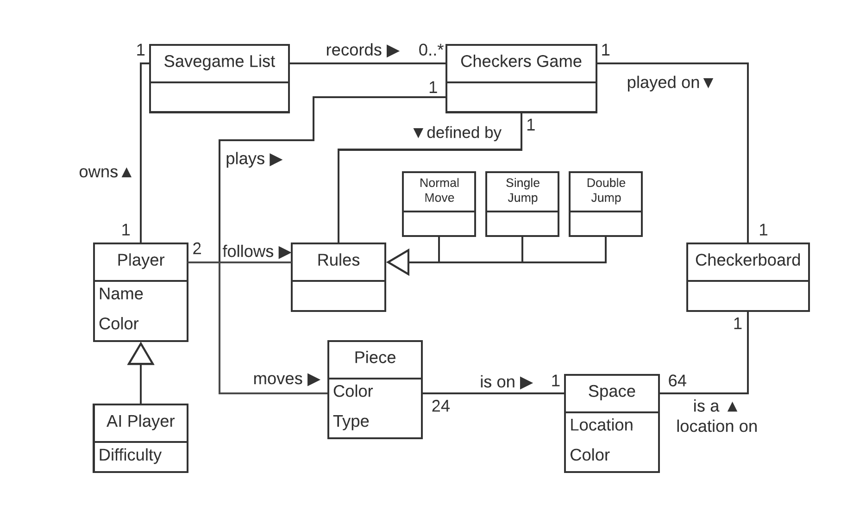
Domain

Slide 3
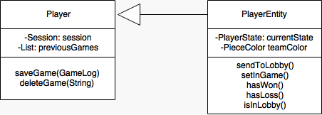
Player Entity And Player
Why?
Player Entity holds what is necessary for both Player and AI
Responsibilities ( Player Entity )
Holding the state
In game
In Lobby
Win/ loss
Team Color
Responsibilities ( Player )
Holding the Session
Holding Saved Games

Slide 4

Logging in

Slide 5
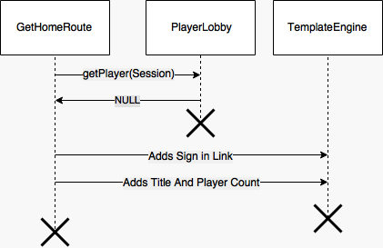
User Not Logged In

Slide 6

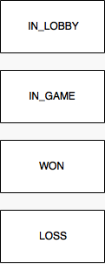

Slide 7
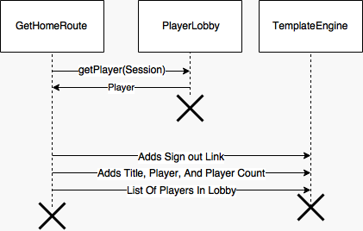
User Is Logged In

Slide 8

Challenge

Slide 9
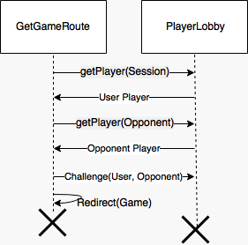
Challenger Selects Player

Slide 11
Resignation

Slide 12
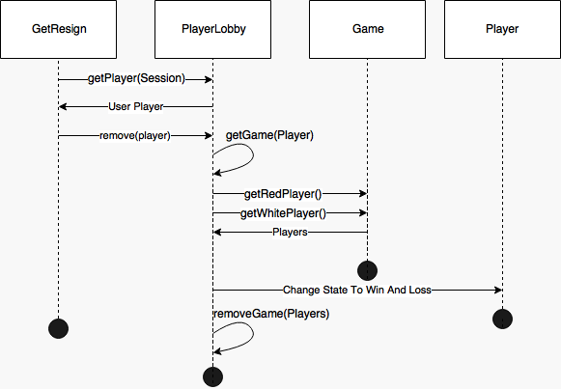

Player Resignation
X
X
X
X

Slide 13
OR

Slide 14
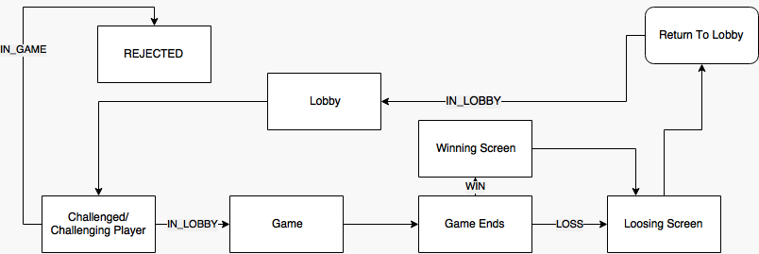
Review

Slide 15

Game Saving

Slide 16

GameLog
Why?
We want our users to be able to watch as they ride to Checker victory
Responsibilities
Save who played which color
Save every move that was finalized
Save when the game started

Slide 17
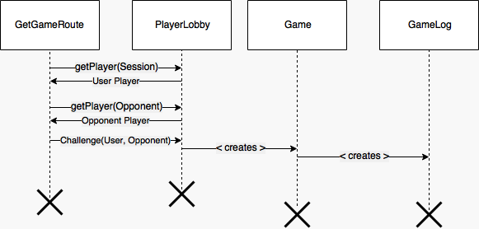
How does GameLog Get Created

Slide 18
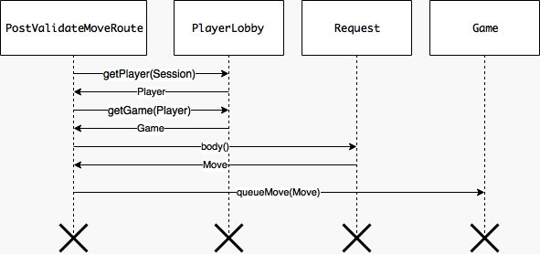
To understand Saves you have to understand move

Slide 19
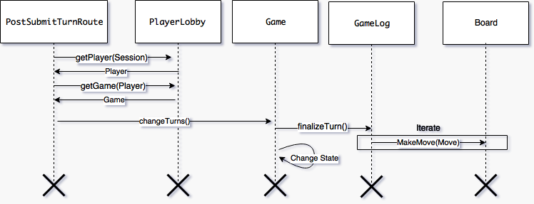
Movement and Saving that movement

Slide 20


